Slide 1
Strategic Human Resource Management and the HR Scorecard
Part 1 | Introduction
Chapter 3

Slide 2

After studying this chapter, you should be able to:
Outline the steps in the strategic management process.
Explain and give examples of each type of companywide and competitive strategy.
Explain what a strategy-oriented human resource management system is and why it is important.
Illustrate and explain each of the seven steps in the HR Scorecard approach to creating human resource management systems.

Slide 3
The Strategic Management Process
Strategic Management
  The process of identifying and executing the organization’s mission by matching its capabilities with the demands of its environment.
Strategy
  A chosen course of action.
Strategic Plan
  How an organization intends to balance its internal strengths and weaknesses with its external opportunities and threats to maintain a competitive advantage over the long-term.

Slide 4
Business Vision and Mission
Vision
  A general statement of an organization’s intended direction that evokes emotional feelings in organization members.
Mission
  Spells out who the company is, what it does, and where it’s headed.

Slide 5
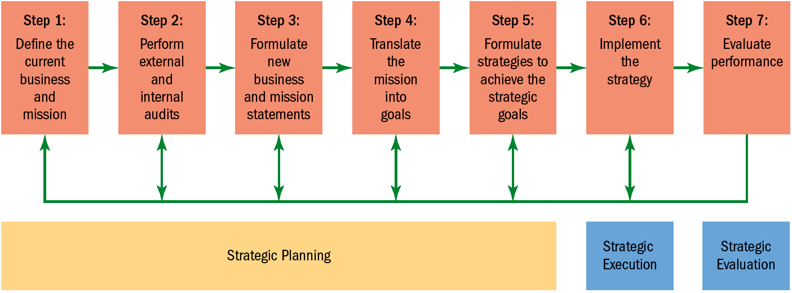
FIGURE 3–1 The Strategic Management Process

Slide 6
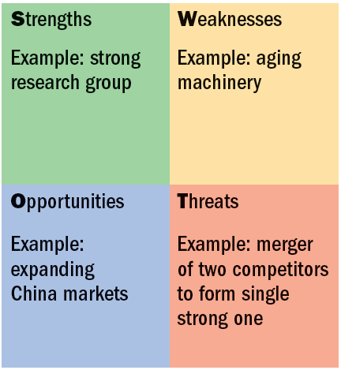
FIGURE 3–2 A SWOT Chart

Slide 7
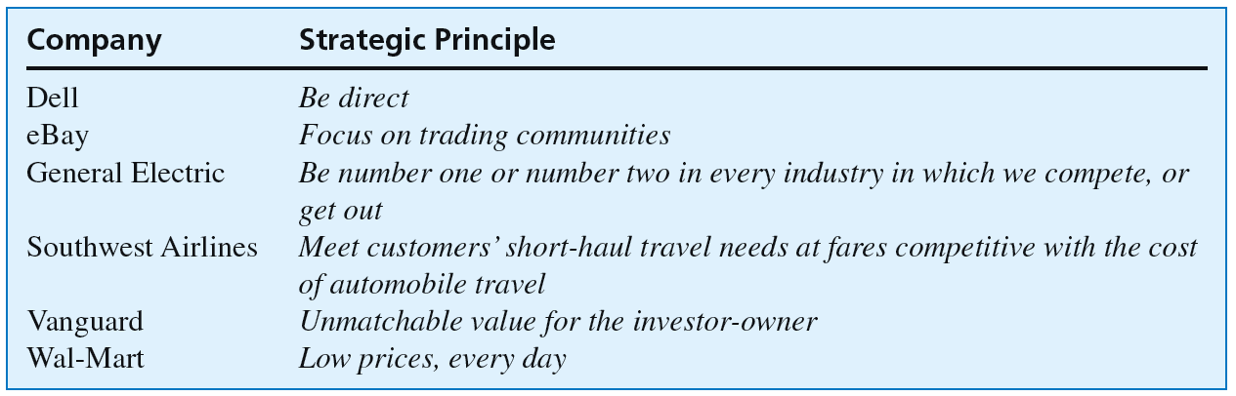
FIGURE 3–3 Strategies in a Nutshell
Source: Arit Gadiesh and James Gilbert, “Frontline Action,” Harvard Business Review, May 2001, p. 74.

Slide 8
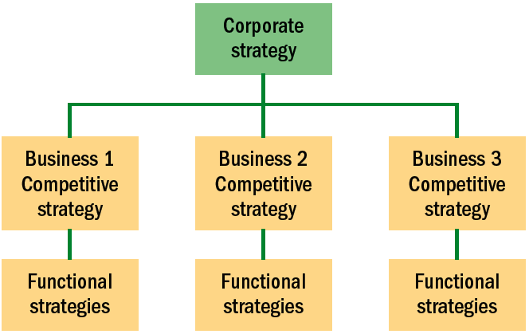
FIGURE 3–4 Relationships Among Strategies in Multiple-Business Firms

Slide 9




Types of Strategies
Corporate-Level Strategies
Diversification Strategy
Vertical Integration Strategy
Consolidation
Strategy
Geographic Expansion Strategy

Slide 10
Types of Strategies (cont’d)
Business-Level/
Competitive Strategies
Cost Leadership
Differentiation
Focus/Niche

Slide 11
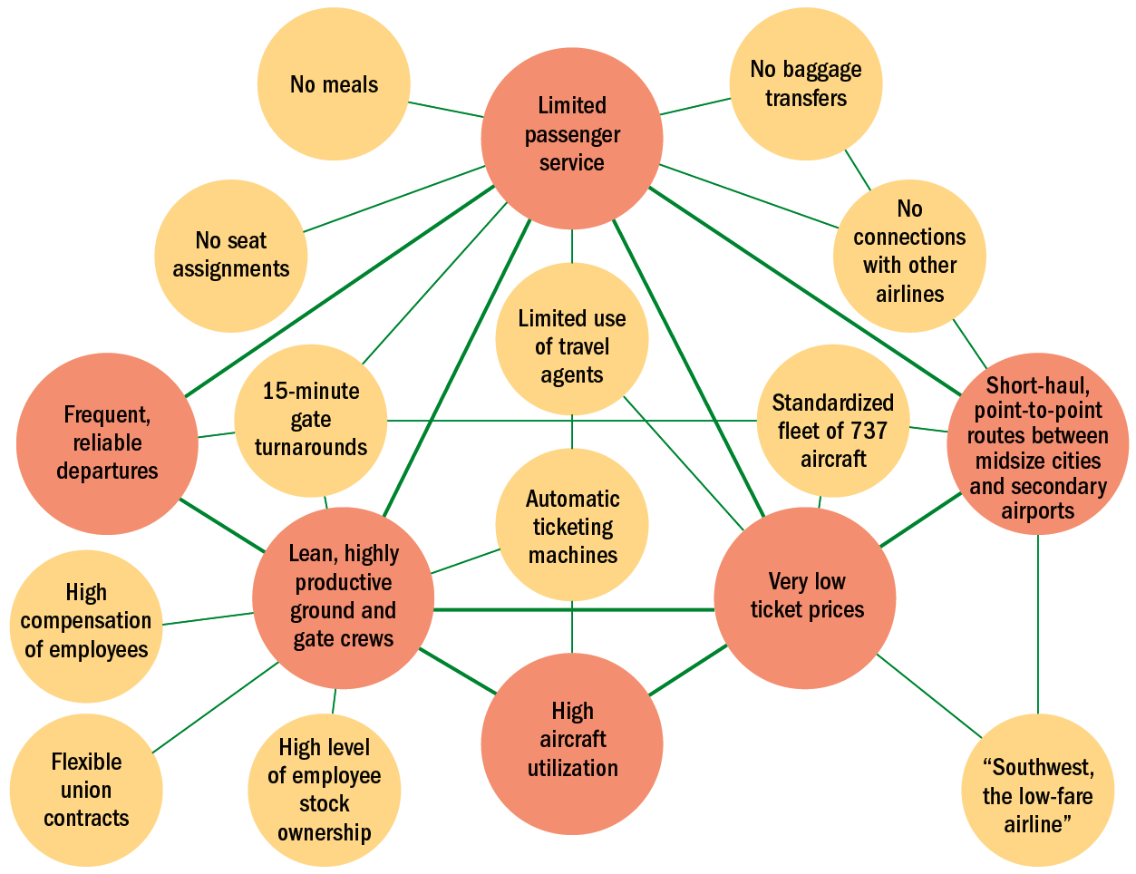
FIGURE 3–5
The Southwest Airlines’ Activity System
Source: Michael E. Porter, “What Is Strategy?” Harvard Business Review, November–December 1996. Reprinted with permission.
Note: Companies like Southwest tailor all of their activities so that they fit and contribute to making their strategies a reality.

Slide 12
Achieving Strategic Fit
The “Fit” Point of View (Porter)
  All of the firm’s activities must be tailored to or fit the chosen strategy such that the firm’s functional strategies support its corporate and competitive strategies.
Leveraging (Hamel and Prahalad)
  “Stretch” in leveraging resources—supplementing what you have and doing more with what you have—can be more important than just fitting the strategic plan to current resources.

Slide 13
Strategic Human Resource Management
Strategic Human Resource Management
  The linking of HRM with strategic goals and objectives in order to improve business performance and develop organizational cultures that foster innovation and flexibility.
    Involves formulating and executing HR systems—HR policies and activities—that produce the employee competencies and behaviors that the company needs to achieve its strategic aims.

Slide 14
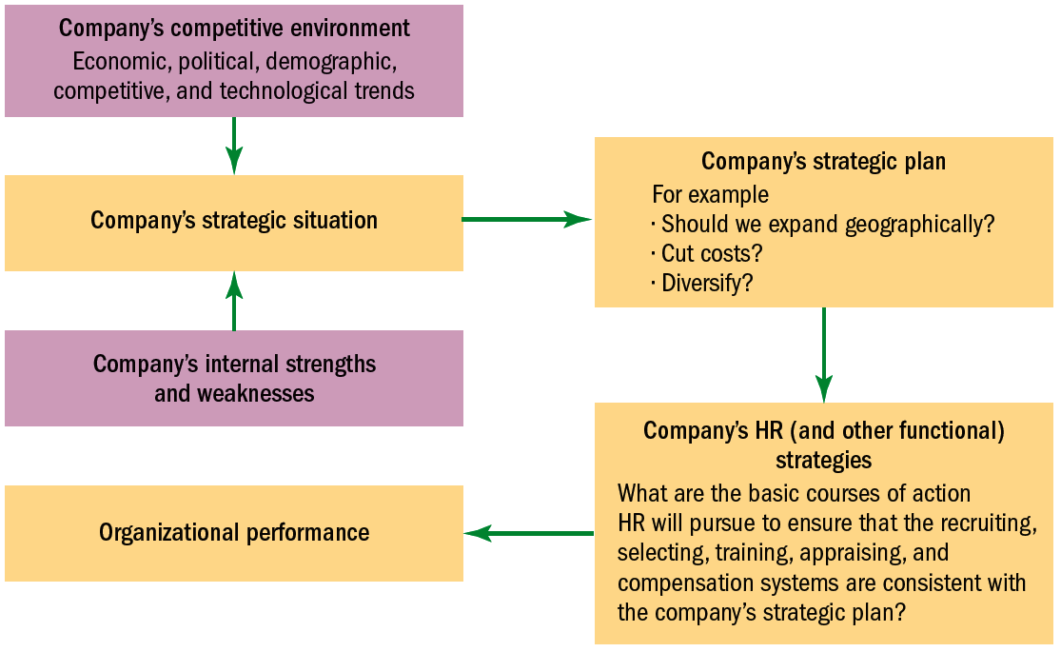
FIGURE 3–6 Linking Company-Wide and HR Strategies
Source: © Gary Dessler, Ph.D., 2007.

Slide 15
Strategic Human Resource Challenges
Basic Strategic Challenges
Corporate productivity and performance improvement efforts
Expanded role of employees in the organization’s performance efforts
Increased HR team involvement in design of strategic plans

Slide 16
Human Resource Management’s Strategic Roles
Strategic Planning Roles
Strategy Execution
Role
Strategy Formulation Role

Slide 17
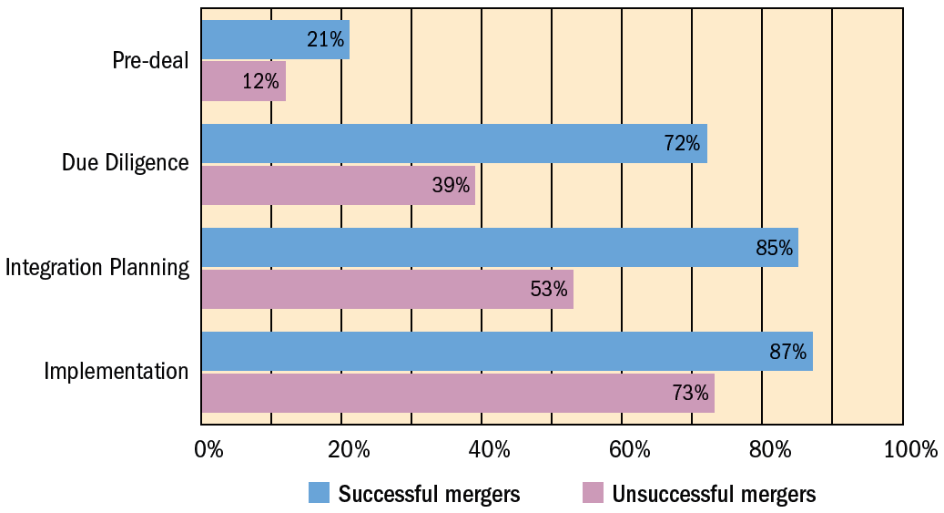
FIGURE 3–7 Percent of Successful Mergers in Which HR Manager Was Involved
Source: Jeffrey Schmidt, “The Correct Spelling of M & A Begins with HR,” HR Magazine, June 2001, p. 105. Reproduced with permission of Soc. for Human Resource Mgmt. via Copyright Clearance Center.

Slide 18
Creating the Strategic Human Resource
Management System
Components of a Strategic HRM System
Human Resource Professionals
Human Resource Policies and Practices
Employee Behaviors and Competencies

Slide 19
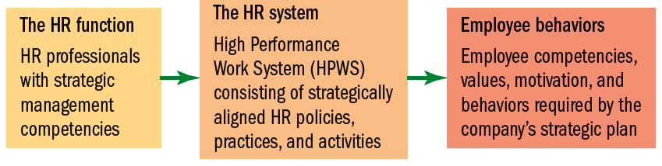

FIGURE 3–8 Three Main Strategic Human Resource System Components
Characteristics of HPWS
multi-skilled work teams
empowered front-line workers
extensive training
labor-management cooperation
commitment to quality
customer satisfaction
Source: Adapted from Brian Becker et al., The HR Scorecard: Linking People, Strategy, and Performance (Boston: Harvard Business School Press, 2001), p. 12.

Slide 20
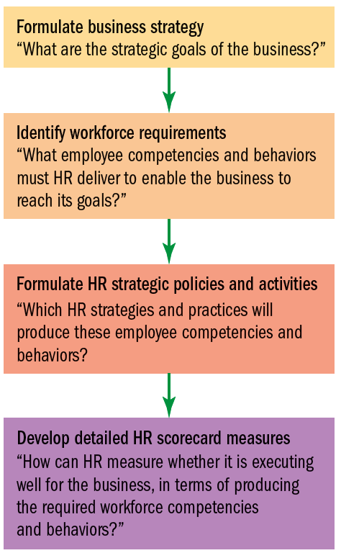
FIGURE 3–9
Basic Model of How to Align HR Strategy and Actions with Business Strategy
“
Source: Adapted from Garrett Walker and J. Randal MacDonald, “Designing and Implementing an HR Scorecard,” Human Resources Management 40, no. 4 (2001), p. 370.

Slide 21
K E Y T E R M S
strategic plan
strategic management
vision
mission
SWOT analysis
strategy
strategic control
competitive advantage
leveraging
strategic human resource management
HR Scorecard
metrics
value chain analysis

Slide 22

FIGURE 3–A1 The Basic HR Scorecard Relationships
HR
Activities
Emergent Employee Behaviors
Strategically Relevant Organizational Outcomes
Organizational Performance
Achieve Strategic Goals

Slide 23
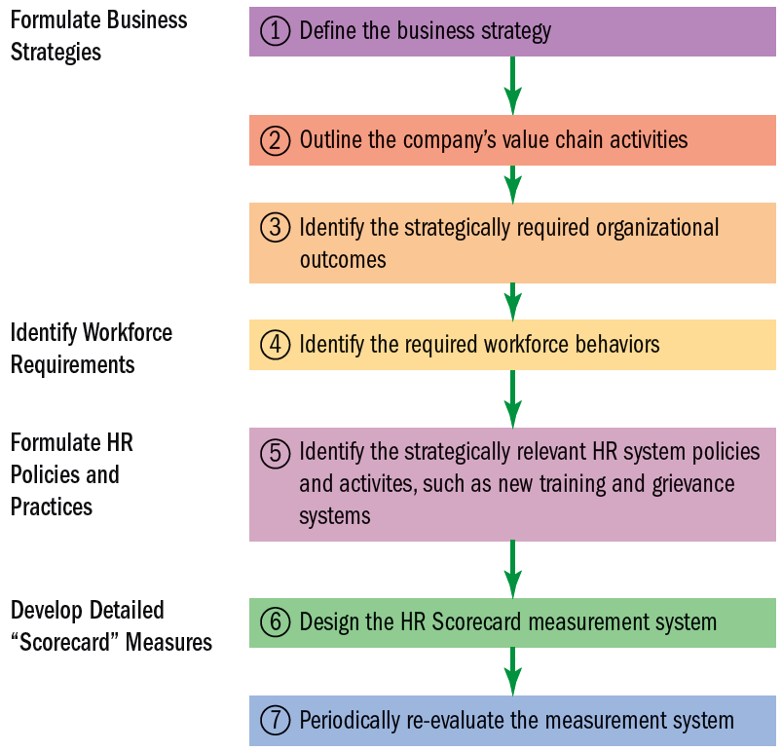
FIGURE 3–A2 The Seven Steps in the HR Scorecard Approach to Formulating HR Policies, Activities, and Strategies
Source: © Gary Dessler, Ph.D., 2007.

Slide 24
Creating an HR Scorecard
The 10-Step HR Scorecard Process
1
Define the business strategy
6
Identify required HR policies and activities
2
Outline value chain activities
7
Create HR Scorecard
3
Outline a strategy map
8
Choose HR Scorecard measures
4
Identify strategically required outcomes
9
Summarize Scorecard measures on digital dashboard
5
Identify required workforce competencies and behaviors
10
Monitor, predict, evaluate

Slide 25
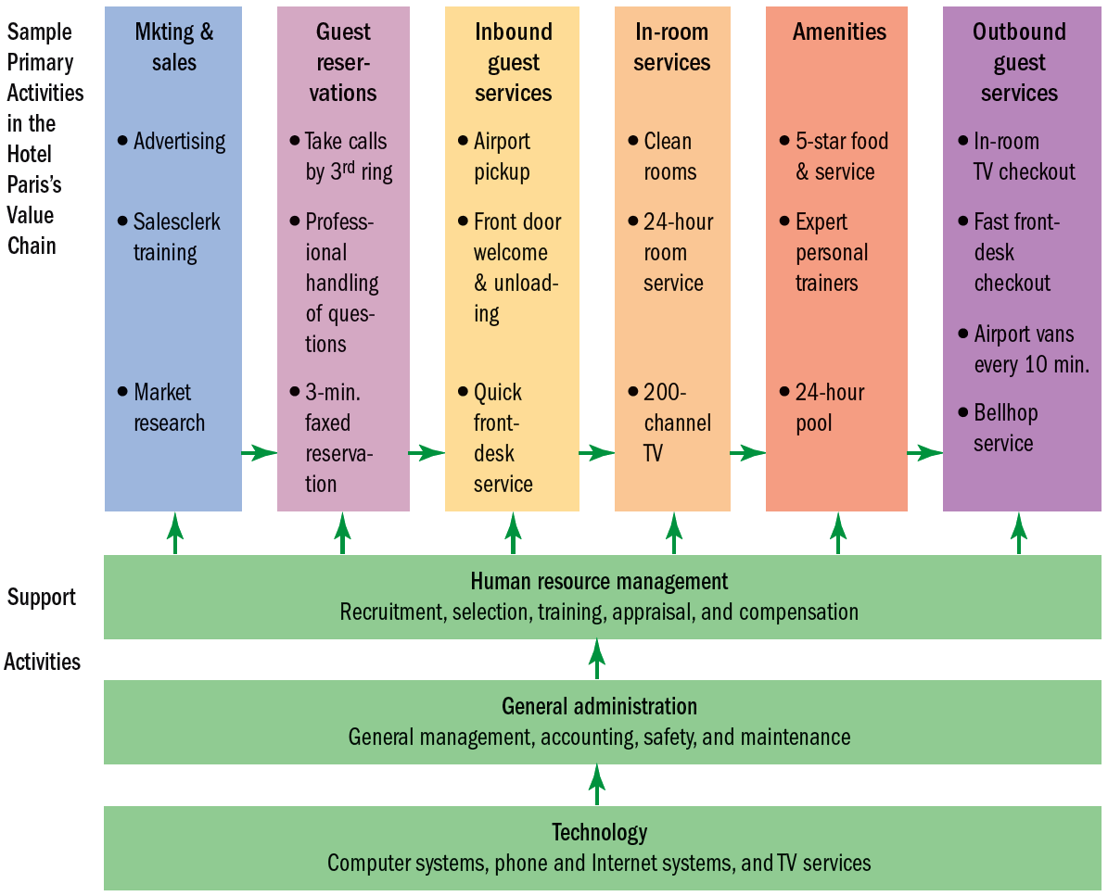
FIGURE 3–A3 Simple Value Chain for “The Hotel Paris”
Source: © Gary Dessler, Ph.D., 2007.

Slide 26
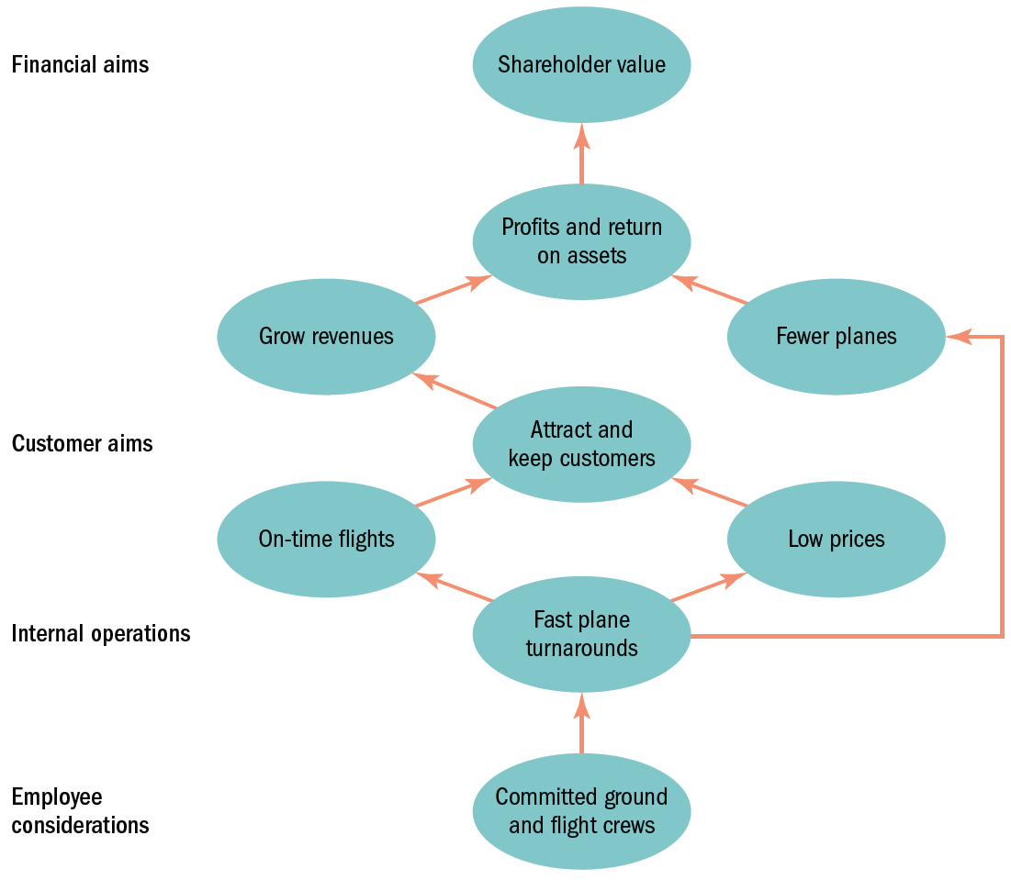
FIGURE 3–A4
Strategy
Map for Southwest Airlines
Source: Adapted from “Creating a Strategy Map,” Ravi Tangri, Team@TeamCHRYSALIS.com.

Slide 27
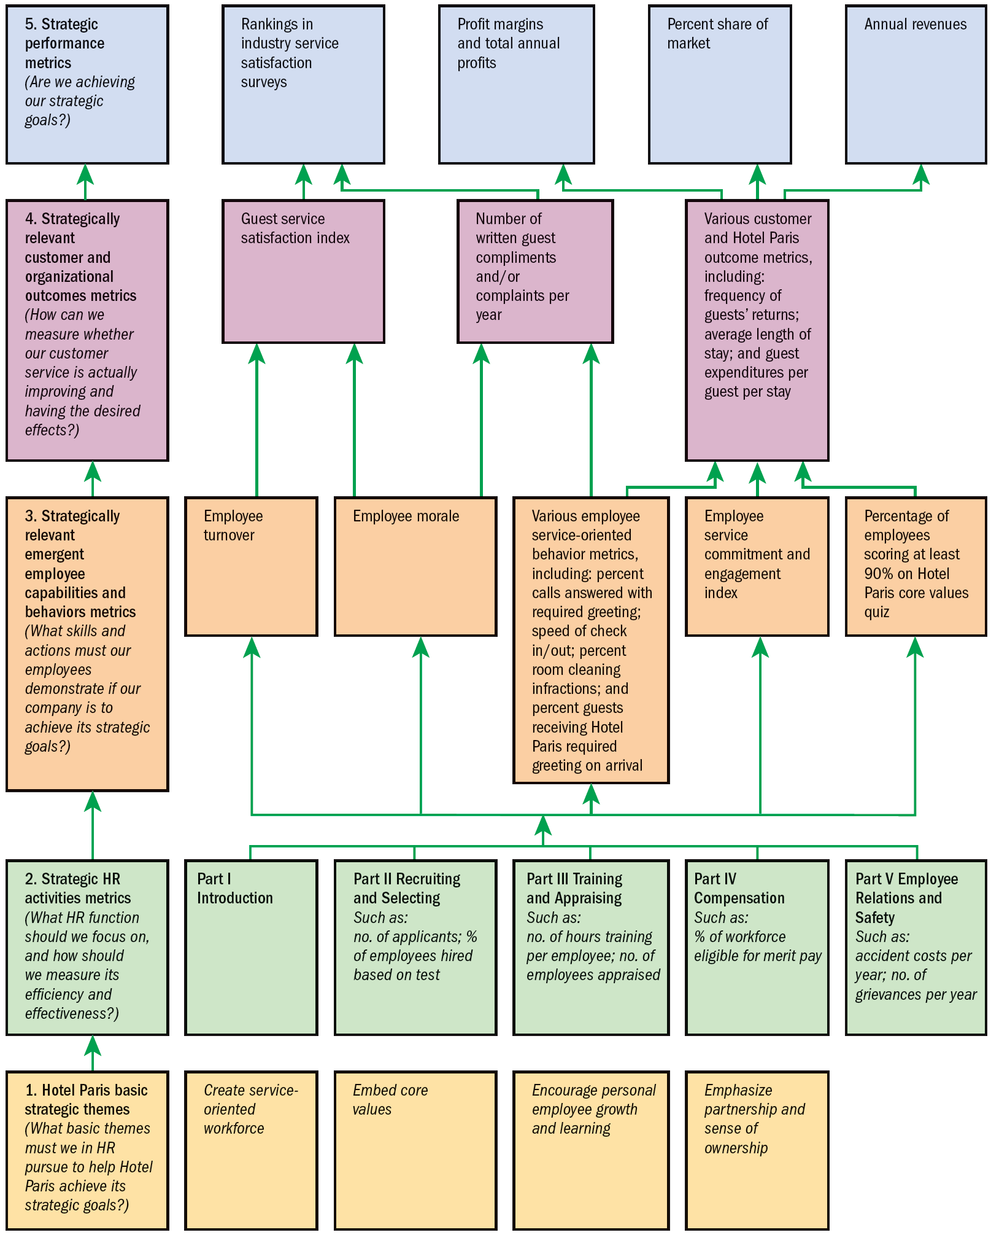
FIGURE 3–A5
HR Scorecard Process for Hotel Paris International Corporation*
*Note: An abbreviated example showing selected HR practices and outcomes aimed at implementing the competitive strategy, “To use superior guest services to differentiate the Hotel Paris properties and thus increase the length of stays and the return rate of guests, and thus boost revenues and profitability and help the firm expand geographically.”

